Slide 1
The Impact of Psychological Distance for Hedonic Luxury Pursuits
6th international Consumer Brand Relationships Conference 19 – 21 May 2019
Faheem Ahmed
Pierre Valette-Florence

Slide 2
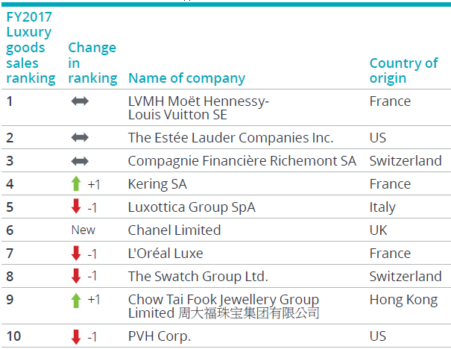
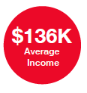
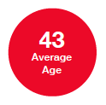
Stats 101
Net aggregate sales by Top 100
US$ 247 billion
Economic share of Top 10
48.2%
Purchases by Gens Y, Z
33%
Growth in online luxury purchases 22%
Purchases by Chinese nationals
33%
HENRY (High Earners Not Rich Yet)
“To appeal to the growing global affluent millennial population, high-end companies are abandoning previous
long-held beliefs that exclusivity and high prices were essential brand characteristics.”
Source: Equifax (2016); Global Powers of Luxury Goods (Deloitte, 2018); Luxury Goods Worldwide Study (Bain, 2018)
Notes:
Continuous growth in online luxury shopping for 2018, to nearly $31 billion; 10% of all personal luxury sales. 44% online luxury sales from Americas, then Asia 29 & Europe 27.
Chinese share of global luxury spending continued to rise (33%), mainland China’s share rose to 9%
Flat tourist purchases on average in 2018, decline in tourist purchases in major EU markets. Generations Y and Z accounted for 33% of luxury purchases and 47% of luxury consumers.
usman mamu cannot find his preferred rolex watch model and has to wait for them to arrive or ask a friend overseas to bring. Henrys (Henrietta) are digital savvy, love online shopping and are big spenders. HENRYs likely to become wealthiest members of society. Luxury: build client relationships with those most likely to be the most affluent consumers. Loyalty of HENRYs could be built by endorsing their core values, such as authenticity, relatability.

Slide 3
Research objectives
Assess proximity to luxury brands in the context of hedonic consumption
Understand the motivations for counterfeit vs authentic luxury consumption
Determine self-perceptions of different consumer segments within the luxury sector
Notes:
The focus of this research is on how people see their ‘selves’ within the process of luxury consumption, the differing motivations for the consumption decision and how the perception of luxury impacts the self.

Slide 4
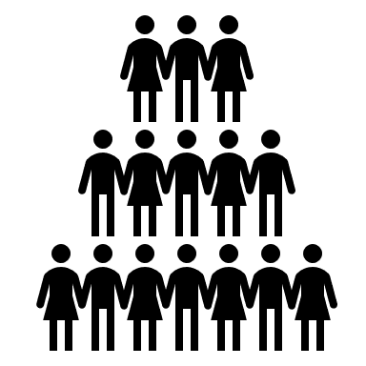
Proximity to Brands?
Luxury brands…hedonistic, desirable, exclusive, rare, artistic, exquisite (De Barnier et al., 2012; Dion & Borraz, 2017; Kapferer, 2012, 2014; Kessous et al., 2017)
Luxury consumption as a means to achieve ideal self
Choice of genuine vs counterfeits to signal proximity to ideal self (Gino et al., 2010; Han et al., 2010)
Resistance to counterfeiting behavior (Mourad & Valette-Florence, 2016; Penz & Stottinger, 2005)
Social consumption of luxury brands (Wang & Griskevicius, 2014; Wilcox et al., 2009)
Construal level theory and psychological distance (Trope and Liberman 2003, 2010)
Impact of proximity perceptions on luxury consumption, product evaluation, ad attitude (Chang & Pham, 2013; Kim et al., 2008; Yu et al., 2017; Zhao & Xie, 2011)
H1: Psychological proximity to a luxury brand would positively impact the motivation to consume luxury brands.
Notes:
1, Luxury products usually marketed as desirable brands, with the ability to sell dreams. Moderate penetration, only accessible to a few. Escape from reality, status consumption, Artification. Are the brands getting too far from their customers?
2, direct experiences in the “here and now” can be concretely defined. Anything not present within current reality is distal & has to be constructed, things might not be present in the current reality for four reasons. perceptions of the same object can vary based on how a person thinks of it. These perceptions, conceptualized as the construal level theory, influence how much we perceive ourselves to be distant from objects and experiences.
3, Psychological distance on any one dimension can trigger distance on other dimensions as well. Greater proximity means the perception of being close to the product and its offered “subjective” hedonic experience Does abstract construal in luxury branding trigger a distance between the brand and the self?

Slide 5
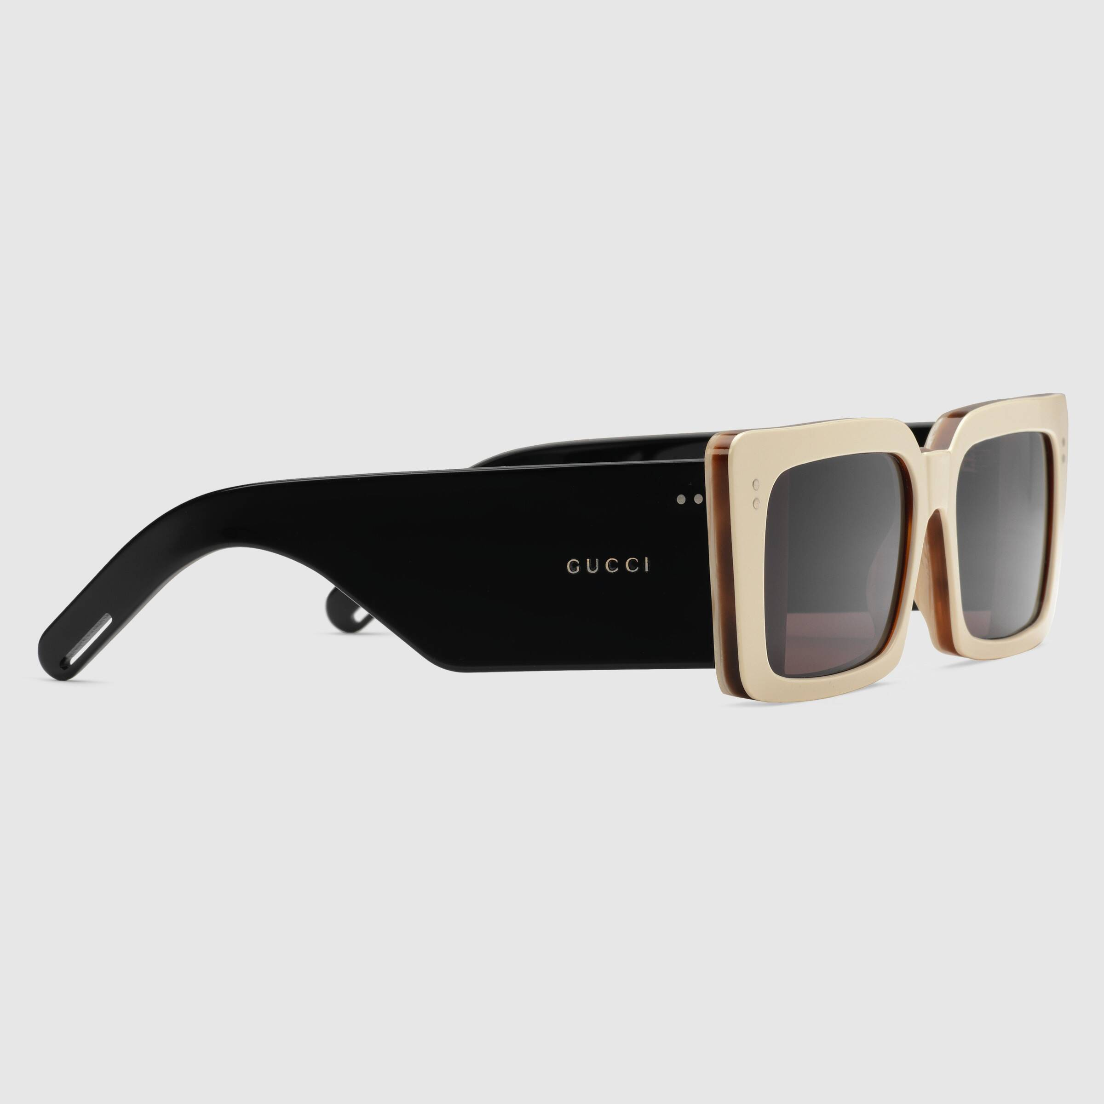
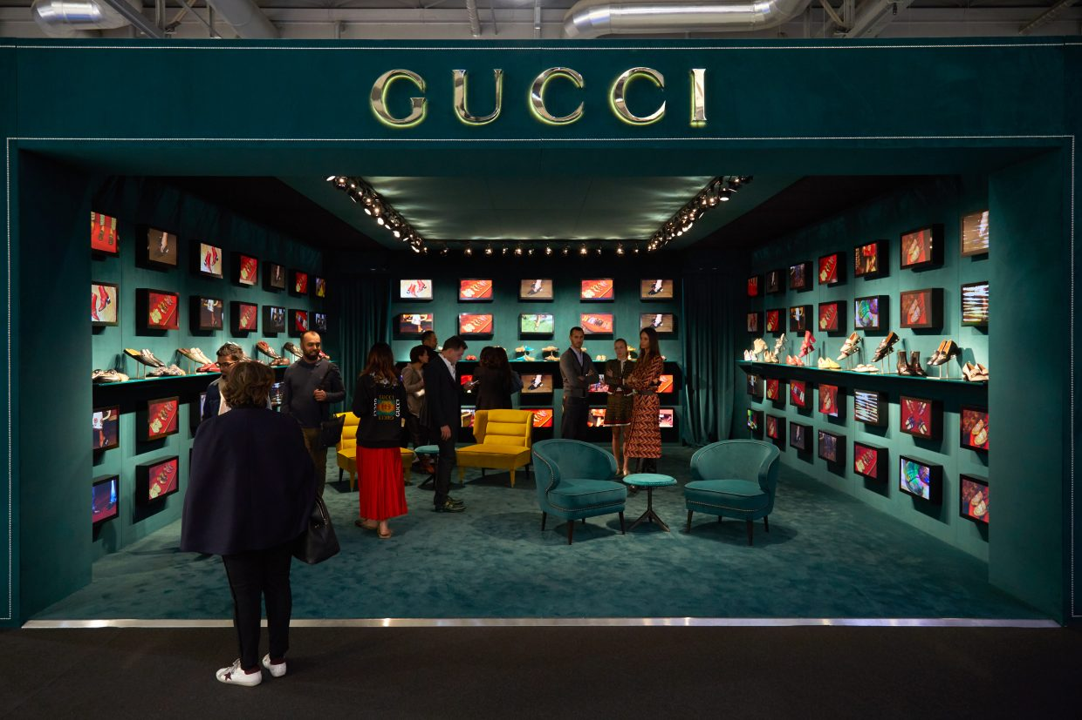
Are you Fakin’ it?
$500,000,000,000 industry (ACG, 2018)
 | Self- authenticity | Goal | Consumption
 | High perceptions of self-authenticity | Engage in authenticating actions | Through genuine luxury consumption
 | Low perceptions of self-authenticity | Low importance to actions | Indulge in counterfeit consumption
H2: Self-authenticity would positively (negatively) moderate the impact of psychological proximity on luxury motivations for an authentic luxury (a counterfeit) brand.
H3: Luxury motivations for an authentic (counterfeit) brand would positively (negatively) influence the intention to purchase authentic luxury products.
Source: Ali Baba’s Anti-Counterfeiting Deal with Kering
Notes:
“Unauthorized representation of a registered trademark…with a view to deceiving the purchaser into believing that he/she is buying the original goods” (OECD, 2002)
need to better undersand the psychology of consumers, their motivations, self-perceptions.
experience real luxury, signaling a positive trait of wealth
Look-alike knock-offs with highly visible logo or quiet logo
Value-expressive: communicating your beliefs/values to the environment. Preference for authentic luxury brands because of high product quality and self-expression
Social-adjustive: desirability, self-presentation, maintain relationships in the society. Preference for counterfeit because of ability to emulate luxury consumers
High authenticity (engage in authenticating actions through genuine consumption), low authenticity (low importance, indulge in counterfeits)

Slide 6
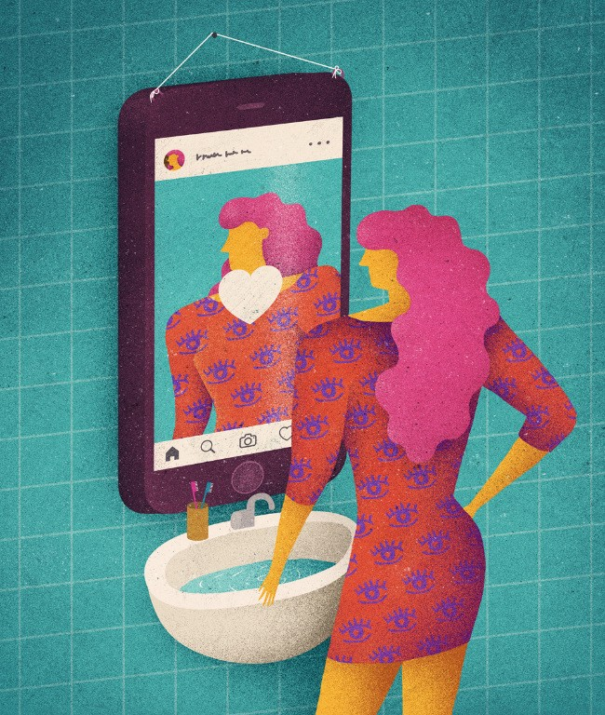
Purchase Intentions
Social purchase decisions
H4: Self-consciousness would positively influence the motivations for: a) authentic, and b) counterfeit, luxury brands.
H6: Shame arising for a counterfeit luxury purchase would positively influence future purchase intentions for authentic luxury.
H5: Self-consciousness would: a) positively influence the intention to purchase: a) authentic, and b) counterfeit, luxury brands.
Notes:
Luxury purchases are mainly a social decision, Purchase luxury products that align with self-image…+ self-presentation, has been shown to influence purchase intention for genuine luxury brands. Self-consciousness: “awareness of the self as a social object and that others are aware of the self”, are imp concerns for behaviors occurring within social environment such as conspicuous consumption of luxury, regardless of authenticity
Imperative to consider a social emotion for the socially instigated behavior of luxury consumption. Induces fear of exclusion and is more relevant for social contexts as opposed to pride (self-induced) and regret (self-directed). Shame is commonly used in marketing communications advising against socially unacceptable actions such as counterfeiting. A feeling of negative moral emotion based on self-view and luxury motivation to curb future counterfeiting consumption

Slide 7
Research causal model and hypotheses

Slide 8
Methodology
Online questionnaire, recuitment through snowball method
Selection of a well-known, uni-sex, luxury brand (Rolex wristwatches)
2 (psychological proximity: near vs. far) x 2 (luxury brand: authentic vs. counterfeit) experiment design
Visual and textual manipulations for the four conditions
Successful manipulation checks for counterfeit and authentic luxury conditions
Frequent users of wristwatches, with high recall and familiarity with the Rolex brand
Demographics
Sample | 150 respondents from Asia, Europe
Gender | 48% females
Education | 96% with a Bachelor’s or higher qualification
Income | 52% earning more than $ 3,000 / month
Notes:
Use: 68% wear frequently with 35% wearing everyday
Recall: mentioned among top of mind awareness brands by respondents
93% were aware of Rolex brand & its wristwatches
Half of the sample owned a Rolex product

Slide 9
Main Results
Model fit values of GoF (authentic: 0.674; counterfeit: 0.615) and SRMR (authentic: .078; counterfeit: .083) withinecommended thresholds
Reliability (Cronbach α) > 0.7 and convergent validity (AVE) > 0.5 for first- and second-order constructs
Bootstrapping approach with 5,000 replications showed all paths to be statistically significant
H1, H4, H5, H6 validated
H2, H3 partially validated & opposite effect of H5 for authentic luxury store
Huge proportion of respondents were convinced to replace their current watch with a genuine watch (98%)
Notes:
GOF far above the 0.36 threshold for excellent fit suggested by Wetzels, Odekerken-Schröder, & Van Oppen, (2009) and identical to the bootstrapped GoF values

Slide 10
Synthesis of results
Consumers | Psychological proximity
Authentic luxury brand | Significant influence on luxury motivations for both sets of consumers (H1)
Counterfeit luxury brand
Self-authenticity | Luxury motivations
High authenticity with purchases (H2a) | Formed through authenticity and consciousness (H2, H4)
No impact on luxury motivations (H2b) | Formed through consciousness and psychological proximity (H1, H4)
Self-consciousness | Shame | Luxury purchase intent (authentic)
Attenuate purchase decisions (H5), but influence luxury motivations (H4) | Harmful for purchase intentions (H6) | Influenced greatly by luxury motivations, but diminished by self-consciousness and shame
Direct influence on purchase decisions (H5) + motivations (H4) | Conversion to authentic luxury purchases (H6) | Very strong influence of shame from counterfeit purchases
Notes:
Authentic luxury consumers are not engaging in conspicuous consumption, possibly because of low need for status
In absence of self-authenticity, psychological proximity plays important role for luxury motivations

Slide 11
Research contributions
Academic
Practical
Empirical demonstration of factors for choice of authentic/counterfeit luxury
Processing mechanisms for authentic vs counterfeit luxury brand choice
Application of psychological proximity and shame within counterfeiting
Impact of distance perceptions and self-views on choice of luxury
Design ads focused on the proximal future or present
Retain loyalty of authentic luxury consumers and evade switching
Luxury brands lend greater authenticity (self) and visibility (social)
Shame and social embarassment within anti-counterfeiting messages
Notes:
2, using luxury motivations as a function of psychological proximity
3. employing psychological proximity is equally important in anti-counterfeiting efforts as it can be used for targeting individual consumers’ luxury attitudes as well as ensuring that current users of authentic luxury do not switch to counterfeited products. The study is one of the first to employ the emotion of shame in a counterfeiting behavior, whereas previous works have mostly focused on pride, gratitude or regret (Chen et al., 2015; Romani, Gistri, & Pace, 2012).
Practical:
Authentic consumers avoid conspicuous consumption

Slide 12
Limits can be delimited
Introduction
Literature Review
Methodology & Results
Expected Contributions
Single product category considered
Cognitively structured manipulation
Consider the effect of peer/in-group consumption, counterfeit detectability and moral values
Limited sample size, employ a larger public to test validity and consistency of results
Explore longitudinal impact of luxury motivation and anticipated emotion on consequent purchase decisions
Notes:
5. To test the evolving nature of luxury motivations on luxury purchase decisions

Slide 13
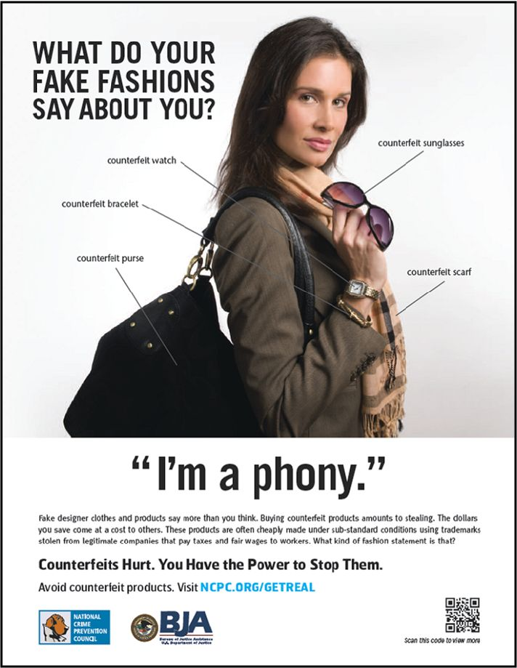
Conclusion
Highlight individual level mechanisms for processing authentic luxury perceptions
Counterfeit luxury consumers
Interested in maintaining a good public appearance
Influence of shame and psychological proximity to authentic luxury stores/brands
Authentic luxury consumers
Assert self-authenticity through luxury purchases to fulfill self-expression goals
Fulfilment of self-expression boosts luxury motivation and purchase
Nuances of social appearance, acceptance and self-image (Thaichon & Quach, 2016; Wilcox et al., 2009; Yoo & Lee, 2009)
Notes:
1, highlight the differences in perception of authentic luxury based on the luxury motivation, self-perceptions, and perceived psychological distance with the brand.
2, counterfeit consumers highly value their public appearance and shame is a social instigator for switching towards authentic luxury brands. Ads with real luxury but reflection of a fake person in the mirror. Self-conscious individuals desire to be impeccable.
3, self-expression and authenticity imp. for luxury motivations driving luxury purchases. emphasize on the authenticity traits of luxury brands and improve psychological proximity with ads focused on strong links and short distance between consumer-brand.
4, in line with existing research on counterfeiting behavior, current research shows that counterfeiting is influenced by public appearance, social acceptance and self-image.

Slide 14
THANKS FOR YOUR ATTENTION Any Questions?...
6th International Consumer Brand Relationships Conference 19 – 21 May 2019
Faheem Ahmed
Pierre Valette-Florence

